Slide 1
CoRe Board 2022 Annual Report
Annual General Meeting (AGM)

Slide 2
Who is core and what do they do
CoRe, also known as CoDA Resource Publishing Inc., is service arm of Co-Dependents Anonymous Inc. (CoDA).
CoRe prints, sells, and distributes English and Spanish CoDA conference approved materials.
These materials are provided in multiple formats including: 1) hardcopy (print), 2) digital (Kindle & iTunes), and 3) audio (MP3).
The income generated from the sales of these materials directly funds CoDA World Programs.
CoRe does not use an outside management company. We manage the day-to-day operations. This includes vendors who provide: 1) warehouse/distribution, 2) on-line store, 3) printing, 4) graphic design, and 5) all administration tasks. Inc. (CoRe) is a not for profit service arm of Co-Dependents Anonymous Inc. (CoDA). We supply

Slide 3
2021 FINANCIALs (Year-to-date)
2021 Sales Income - $431,519.39
2021 Royalties Paid - $137,402.82
2021 7th Traditions Received - $0
Financial Reports are available in Delegate Package at coda.org

Slide 4
2022 Financials (1/01 to 6/22)
2022 Sales Income - $192,771
2022 Royalties Paid - $74,289
2022 7th Traditions Received - $611
Financial Reports are available in Delegate Package at coda.org

Slide 5
English 2021 Year-To-Date Total Sales $354,036
Spanish 2021 Year-To-Date Total Sales $7,812

Slide 6
Literature printed 06/2021 – 06/2022
English
Spanish
Adult Coloring Book
Common Threads
12 & 12 Workbook
12 Steps Handbook
Making Choices
Tools for Recovery
Adult Coloring Book
Peeling the Onion
Communication & Recovery
Adult Coloring Book

Slide 7
2021 Accomplishments
English eBooks created for:
Tools For Recovery
Peeling The Onion
Newcomers Handbook
The 12 Step Handbook
The 12 Piece Relationship Toolkit
Established quantity discounts for English and Spanish CoDA Blue Book (pocket edition)
Established quantity discounts for In This Moment Daily Meditation.
Spanish versions created in 2020

Slide 8
Voting entity (VE) submitted materials
After the VE material is accepted by the CSC and during the 1 year waiting period, CoRe will evaluate whether the material should be sold on the website or if it should be posted as a free download, (aka as “Service Item.”) CoRe will report their findings and the recommended course of action for the materials.
Minimum standards for free (Service) materials.
The content follows the CoDA Literature Committee approved “style guide.”
There are no spelling errors which can be corrected using grammar software.
There are no punctuation errors which can be corrected using grammar software.
All changes have been made prior to publication to website. (Note: this could take more than one year).
A third party vendor can format content at a reasonable cost to CoDA.
Minimum standards “for sale” material.
Content follows the “style guide.”
Editor or CoDA Literature Committee has reviewed and corrected spelling, grammar, punctuation, and syntax errors.
A third party vendor can format content at a reasonable cost to CoDA.
The CoDA Board may be called upon to fund an editor to make the necessary charges.
All changes have been made as requested prior to printing.

Slide 9
CoRe BOARD MEMBERS
Yvonne K. – Chair
Annie S. – Vice Chair
Ritchard L. – Print & Coin Liaison
Kathy H.- Treasurer
Addie M. - Trustee

Slide 10
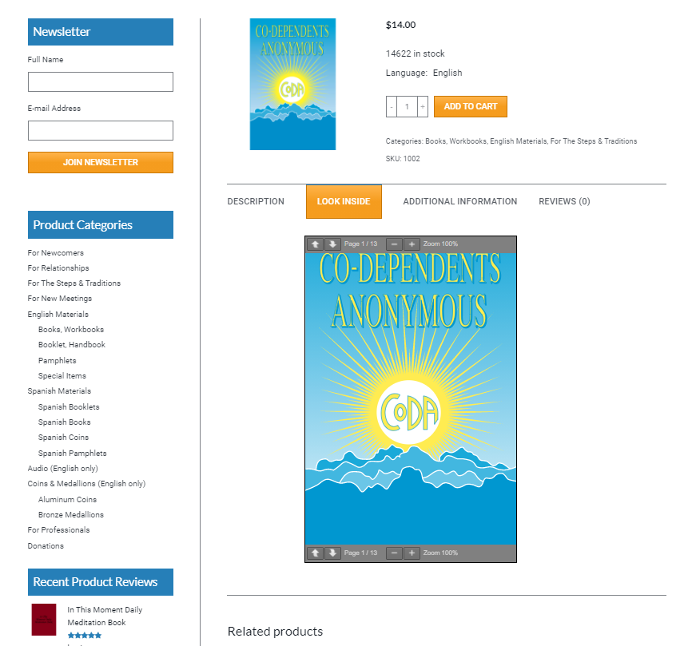
FOR YOUR
INFORMATION
CoRe Website
Offers a
“Look Inside”
Option
“Look Inside” allows everyone to review contents before purchase.

