Slide 1
CoDA Resource Publishing, Incorporated (CoRe) Board 2022/2023 Annual Report

Slide 2
MISSION STATEMENT
Help the “still suffering” codependent by supplying conference approved English and Spanish materials in many formats through our online store to anyone wishing to learn more about codependency and recovery.

Slide 3
WHO IS CORE AND WHAT DO THEY DO?
CoRe prints, sells, and distributes English and Spanish CoDA conference approved materials.
CoRe, also known as CoDA Resource Publishing Inc., is the printing arm of Co-Dependents Anonymous Inc. (CoDA).
CoRe prints, sells, and distributes English and Spanish CoDA conference approved materials.
These materials are provided in multiple formats including: 1) hardcopy (print), 2) digital (Kindle & iTunes), and 3) audio (MP3).
Sales of these materials directly fund CoDA World Programs (approximately 65% - 70% of CoDA’s revenue comes from CoRe).

Slide 4
Total Sales of “Joy in the Journey, Recover with Color” Adult Coloring Book The “Joy in the Journey, Adult Coloring Book” has been translated into Spanish and Russian.
The translations in process currently are The Netherlands, Lithuania, Sweden, and the Czech Republic (Slovak) 2022 We sold 1312 Copies in English 2022 We sold 63 Copies in Spanish 2023 We sold 367 Copies in English 2023 We sold 22 Copies in Spanish

Slide 5
COREPUBLICATIONS.ORG – NAVIGATION CHANGES
Notes:
Can we update this page?

Slide 6
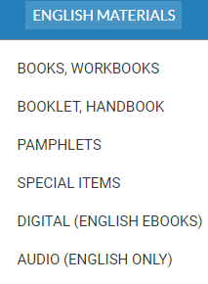
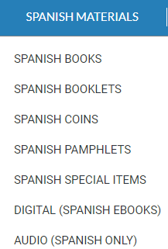
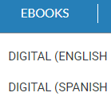
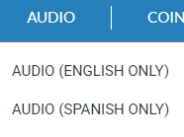

Slide 7
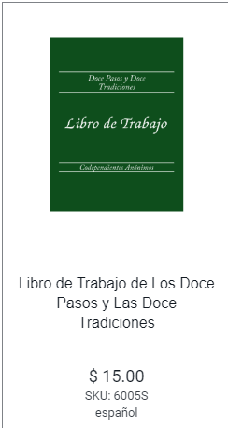
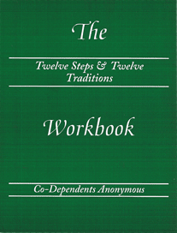
EACH ITEM IS AVAILABLE IN ENGLISH AND SPANISH
Twelve Steps & Twelve Traditions Workbook (Spiral Binding)
$15.00SKU: 6005
English

Slide 8
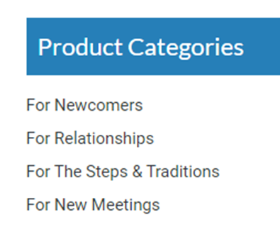
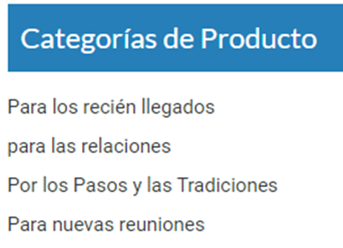
COREPUBLICATIONS.ORG – ADDED PRODUCT CATEGORIES

Slide 9
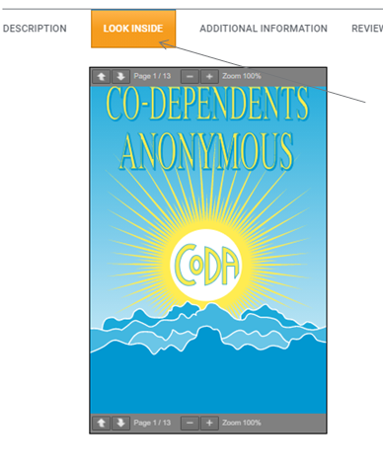
COREPUBLICATIONS.ORG
Look Inside” allows everyone to review contents before purchase.

Slide 10
2022 FINANCIALS YEAR-TO-DATE
2022 Sales Income - $398,422.20
2022 Royalties Paid $159,368.88
2022 7th Traditions Received - $1,178.00

Slide 11
2023 FINANCIALS (1/01 – 6/1)
2023 Sales Income - $225,001.43
2023 Royalties Paid - $80,276.12
2023 7th Tradition Donations - $ 413.82

Slide 12
2022 ENGLISH BEST SELLERS
English Literature 2022 Quantity Amount
1002 CoDA Blue Book 4968 $ 67,200.00
6005 12 Stp. And Trad. Workbook 4999 $126,135.00
1011A In this Moment Meditation Book 2337 $ 28,270.50
1003A Pocket Edition of Blue Book 1282 $ 14,394.50
4101 Newcomers Handbook 4069 $ 12,207.00
4021 Peeling the Onion Booklet 2841 $ 8,523.00
4001 Welcome to CoDA Pamphlet 2574 $ 900.90
4002 Am I Codependent 3428 $ 1,199.80

Slide 13
2022 SPANISH BEST SELLERS
Spanish Literature 2022 Quantity Amount
6005S Doce Pases y las Tradiciones (12 & 12 Workbook) 224 $ 3,360.00
1003S Libro de CoDA (Blue Book Pocket Edition) 856 $ 8,593.00
1011S En Este Momento (In this Moment) 151 $ 1,887.50
4021S Pelando la Cebolla (Peeling the Onion) 152 $ 456.00
7003S Oraciones de CoDA (Prayers) 52 $ 945.00

Slide 14
2023 ENGLISH BEST SELLERS (Jan – June 1)
ENGLISH LITERATURE 2023 (1/23 – 6/1/23) QUANTITY AMOUNT
1002 CoDA Blue Book 2710 $ 56,221.00
1003 Pocket Book 751 $ 21,088.00
1011 In This Moment Meditation Book 1044 $ 18,714.00
4001 Welcome to CoDA Pamphlet 1800 $ 750.00
4002 Am I Codependent Pamphlet 2236 $ 917.60
4005 Communication & Recovery 1617 $ 693.45
4021 Peeling the Onion 1502 $ 4506.00
4101 Newcomer Handbook 2260 $ 6780.00
6005A 12 & 12 Workbook 2035 $ 38,430.00
Welcome Chip 6369 $ 4776,75
1 Month Chip 1311 $ 983.25

Slide 15
2023 SPANISH BEST SELLERS
SPANISH LITERATURE 1/2023 – 6/1/2023 QUANTITY AMOUNT
1003S Spanish Pocket Book 125 $ 3942.00
1011S In this Moment Meditation Book 71 $ 887.50
4002S Am I Codependent? 257 $ 89.95
4021S Peeling the Onion 80 $ 240.00
4101S Newcomers Booklet 41 $ 123.00
7003S Prayer Book 53 $ 185.00
7004S Joy in the Journey, Recover with Color 22 $ 330.00
IN ENGLISH

Slide 16
2023 MEJORES VENDEDORAS ESPANOLAS
LITERATURA ESPANOLA 23/1 – 1/6/23 CANTITAD CANTIDAD
1003S Libro de bolsillo espanol 125 $3942.00
1011S En Este momento, Libro de Meditaciones Diarias 71 $ 887.50
4002S Soy Codependiente? 257 $ 89.95
4021S Pelando la Cebolla 80 $ 240.00
4101S Manual para recien llegados 41 $ 123.00
7003S Oraciones de coda 53 $ 185.00
7004S Un Viaje de Alegria Recuperaciion en Color 22 $ 330.00
duplicado en español

Slide 17
MATERIALS PRINTED FROM 6/2022 - 06/2023
English
Blue CoDA Book
12 & 12 Workbook
12 Steps Handbook
In this Moment Meditation
Healthy Meetings Matter
Adult Coloring Book
Newcomer Handbook
Tools for Recovery
Common Threads of Codependency
Making Choices
Spanish
Adult Coloring Book
4002S ¿Soy codependiente? (En proceso)
Am I Codependent
(In Process)
4003S Asistiendo a reuniones (En proceso)
Attending Meetings (In Process)
4011S Tu primera reunión (En proceso)
Your First Meeting (In Process)

Slide 18
COINS & MEDALLIONS PRODUCED
Medallions (Years): 1, 2, 3, 8, 11, 12, 13, 14, 16, 17, 18, 20, 34, & 37
Coins (Months): Welcome Chip, 2, 3, & 9

Slide 19
ENGLISH* EBOOKS CREATED FOR THESE BOOKLETS:
Kindle Ebook English Version ibook ebook English Version
CoDA Book available on itunes
In this Moment Meditation Book - CoDA Book
Twelve Steps and Twelve Traditions Workbook - In this Moment Meditation Book
Tools for Recovery - 12 Steps and 12 Tradition Workbook
Peeling the Onion - Tools for Recovery
The Twelve Step Handbook - Peeling the Onion
The Twelve Piece Relationship Toolkit - The Twelve Step Handbook
Newcomer Handbook - Newcomers Handbook
- The Twelve Piece Relationship Toolkit

Slide 20
Sponsorship Workshop
In February 2023, the CORE Board collaborated with the Outreach Committee, The Events Committee, and CoDA Board to provide booklets to participants of the Sponsorship workshop at no charge.
Six booklets were selected to encourage participants in sponsorship in CoDA.
These booklets included - (Both English and Spanish)
English Qty. Spanish Qty.
4020 Carrying the Message 98 2
4017 Common Threads 98 2
4019 Making Choices 98 2
4101 Newcomers Handbook 98 2
4023 Sponsorship - Whats in it for Me? 98 2
4016 Tools for Recovery 98 2
Notes:
To be filled out by Addie

Slide 21
PRICE REDUCTION FOR POCKET BLUE BOOK

Slide 22
IN THIS MOMENT CASE PRICING

Slide 23
CURRENT MEMBERS OF THE CORE BOARD
Kathy H. – Acting Chair of the CORE Board/Treasurer
Lorraine K – Vice Chair
Open – Secretary
Open - Treasurer
Joe – Web Liaison
Addie – Acting Print Liaison, Warehouse Liaison
Kirsten - Alternate
Barbara D. – Board Liason

Slide 24
2022-2023 Goals
Goal #1 - Major Reprint of Literature - Completed
Goal #2 Ensure Sustainability of CoRe
Assess needs ot the CoRe Board and procedures
Attract members to CoRe Board - Completed
Goal #3 Increase awareness of CoRe publications - Completed
Create and distribute newsletter in new literature orders - In
process
Goal #4 - Increase revenue Jan 2022 - June 2023 and carry the
message (we increased revenue 25.1%)
Update website to cross sell CoDA complimentary materials.
Completed

Slide 25
2022/2023 CoRe Accomplishments
We accomplished major print jobs this year of the three most sold books (CoDependents Anonymous Big Book, Twelve Steps and Twelve Traditions Workbook, and In this Moment.
We held a face to face meeting in February on zoom.
We have attracted new members to the CoRe Board
We have spread the message that we have free downloadable pamphlets
We have continually been transparent with the CoDA Literature Committee (CLC)

Slide 26
Goals for 2023 - 2024
Goal #1
Train new members - Schedule a Face-to- Face meeting on zoom for Spring
Goal #2
We are investigating the packs of 50 pamphlets because of the expenses we incur selling individually. We will revisit this after the CoDA Service Conference.
Goal #3
Investigating the process to update the translation of the Spanish side of the website
Goal #4
Create a newsletter to send to customers who requested it using A-Weber

Slide 27
GOALS FOR 2023 - 2024
Goal #5-
Increase revenue by increasing prices of literature due to paper cost, which increased 50%
Goal #6
Investigate taking Venmo or other means of payment
Goal #7
Working relationship with the CoDA Literature Committee (CLC), as well as the CoDA Board. Communicate on a regular basis.
Goal #8
Digitally, we currently have 8 pieces of literature on our CoRe store for download. We will be looking at the possibility of placing more downloadable literature on the CoRe website.

Slide 28
IN MEMORY
Yvonne K (NorCal) has been an asset on the CORE Board for five years, and she passed away suddenly on February 22, 2023 of this year.
We thank her for her contributions and will use her example to go forth. We will miss her greatly and all she has brought to this board.

Slide 29
WITH GRATITUDE TO THE FELLOWSHIP
Thank you for your purchases of our literature and continued support of the CORE Board. Thank you CoDA for trusting us with the literature sales.
We are always looking for new members, and if you are interested, please reach out to Board@corepublications.org.

