Slide 1
CoDA Ontario Intergroup
Ontario, Canada
codaontariointergroup@gmail.com

Slide 2
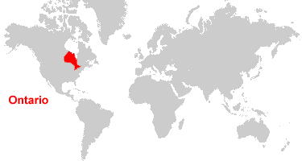

Slide 3
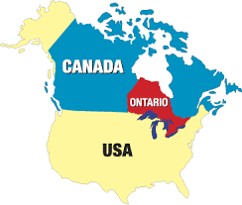

Slide 4
CoDA Ontario Intergroup
The Intergroup formed in 2022 to support the 35+ CoDA groups meeting within Ontario
This past year’s focus was on creating and finalizing our by-laws and continuing to outreach to groups within the Province
Trusted Servants at this time include:
Chair (Patty H)
Co-Chair (Mo)
Treasurer (Leane G)
Secretary (vacant)

Slide 5
Future Plans
To continue to build the internal infrastructure and supports
Recruit additional members to the regular meetings
Plan a Province wide online workshop and speaker conference
Supporting the CoDA Thurs Noon/Host City for CSC/ICC 2024

