Slide 1
CoDAteen Committee

Slide 2
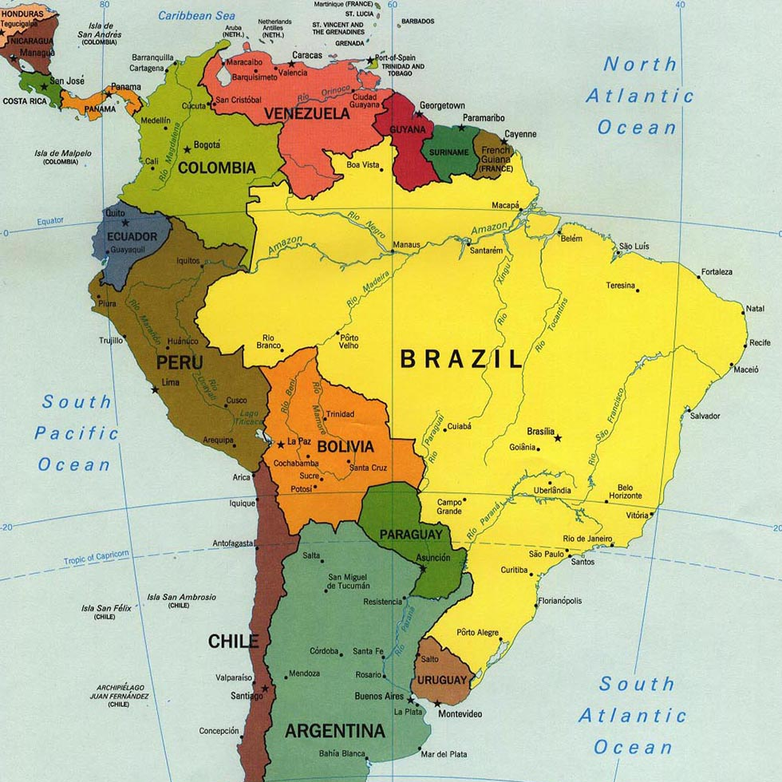
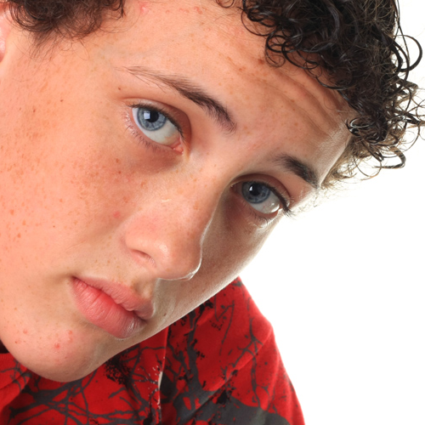
History of CoDAteen
In 2007, CSC disbanded CoDAteen.
All CoDAteen materials was no longer to be published and was proposed to be incorporated into materials for CoDA Youth.
In 2021, inspired by feedback from the Spanish speaking community, Spanish Outreach (SPO) met with CoDA from Latin American and other 12 Step members including teens to gather testimonials.
SPO also found a lack of CoDA literature that spoke to the problems that youth face today.
This Photo by Unknown Author is licensed under CC BY

Slide 3
Permanent World CoDAteen Committee
In response to Spanish Outreach (SPO)'s report in 2021, the CoDA Board formed the CoDAteen Task Force comprised of English and Spanish speaking members.
Translation services were provided to enable the groups to work effectively.
In 2022 the taskforce was voted to become a permanent World Committee by CSC.

Slide 4
CoDAteen Committee Members
Rosa S. - California (Chair)
Nadia R. - Argentina
Lieska F. - Venezuela
Marcela G. - Colombia
Keli D. - California
Katya R. - Mexico (Secretary)
Gillian A. - UK
Florence F. -Maryland (Board Liaison)

Slide 5
What is CoDAteen, Purpose and Structure
CoDAteen meetings must be sponsored by an individual CoDA group, Intergroup, Regional, or Voting Entity and must be registered with CoDA World.
A CoDAteen meeting may not be registered without a sponsoring CoDA group.
The sponsoring group is responsible for vetting and training adult hosts/sponsors involved with CoDAteen meetings.
The CoDAteen committee is responsible for reviewing each CoDAteen group's process and for the registration approval of of the CoDAteen meeting.

Slide 6
CoDAteen World Committee Goals and Objectives 2023-2024
Reach
Reach young people around the world by offering age appropriate meetings that are safe and secure for teenagers to develop healthy and loving relationships with themselves, others and their Higher Power.
Develop
Develop and Create a CoDAteen Training Guide for Adult Hosts/Sponsors per the CoDAteen Handbook
Adapt
Adapt and develop the best processes and resources available to reach codependent teens and to provide a safe place for them to share and grow.
Support
Support and encourage groups to create and sponsor new CoDAteen meetings and support CoDAteen meetings already established worldwide by facilitating structure and materials needed.
Continue
Continue to solicit feedback and support from the CoDA Fellowship and CoDAteens to strengthen the program to reach teenagers around the world who are still suffering.

Slide 7
CoDAteen Committee 2023 Report (Work in Progress)
Creation of a “What is CoDAteen?” pamphlet in Spanish and English. (Motion # 4)
CoDAteen webpage in discussions with web developers to finalize.
Creation of thought-provoking and interesting short videos for teenagers and uploaded on the YouTube official CoDA channels in English and Spanish.
Additional Spanish and English CoDA members have joined the committee.
Participation of the Committee in different venues locally and internationally to bring information about CoDAteen

Slide 8
Training for the Host/sponsor
of a CodaTeen Meeting
2023

Slide 9
Start by familiarizing yourself with the CodaTeen Handbook.
Everything you need is spelled out. The focus of this training is found in Section Three of the handbook. There is a CodaTeen Committee there to support you by reaching out to codateen@coda.org.
(Motion # 5)

Slide 10
Parental/Guardian Responsibilities (Motion # 3)
Parental Permission Letter outlining parent's responsibilities
CoDAteen Adult hosts/sponsors only responsible for what happens during the meeting
For medical emergencies, immediate first aid may be given and emergency contact must be notified
Transportation to and from the meetings should be arranged by the parent/guardian

Slide 11
Minimum Behavior and Safety Requirements (Motion # 2)
Every adult CoDAteen host/sponsor must work his/her own program.
Be at least 25 years old with a minimum of 3 years of recovery in CoDA.
Two adult host/sponsor must be present at all CoDAteen meeting.
Adult host/sponsors must be trained per recommendations and resources from CoDAteen at CoDA World.
All Legal requirements for adults working with minors must be observed and followed per countries, regions and states.
Refer to CoDAteen Handbook for additional requirements.

Slide 12
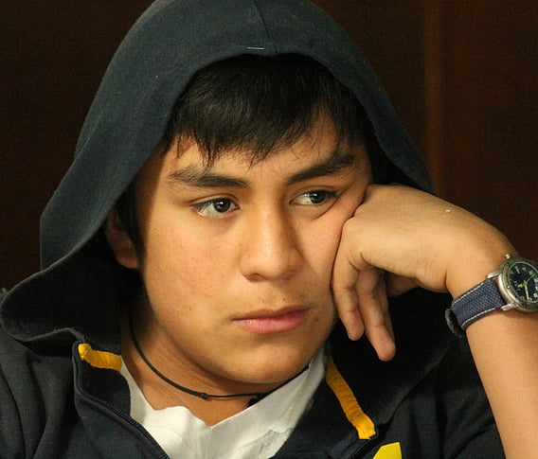
Is CoDAteen for Me? Teenagers share…
“Codependency affects us young people too!”
“We need a safe and secured place to share with others openly and honestly”…where we can learn early on in life how to have heathy and loving relationships with others”
“Thanks to CoDA we are given options and an opportunity to learn how to do that”.
Alejandro, Gilberto, and Melissa Share
Isabel’s share
Experience of newly opened CoDAteen group in Colombia

Slide 13
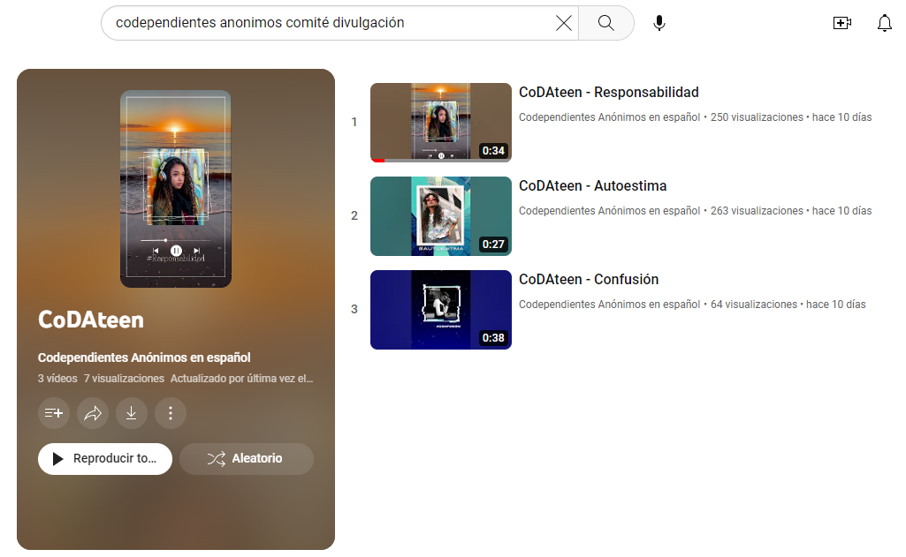
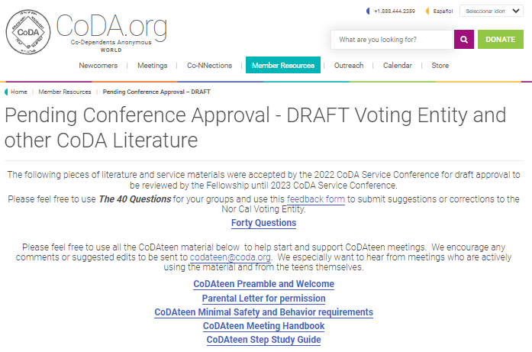
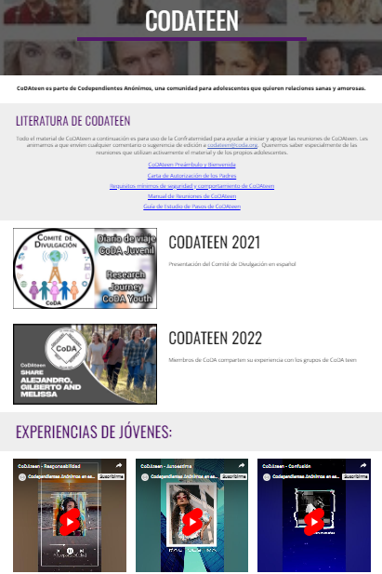
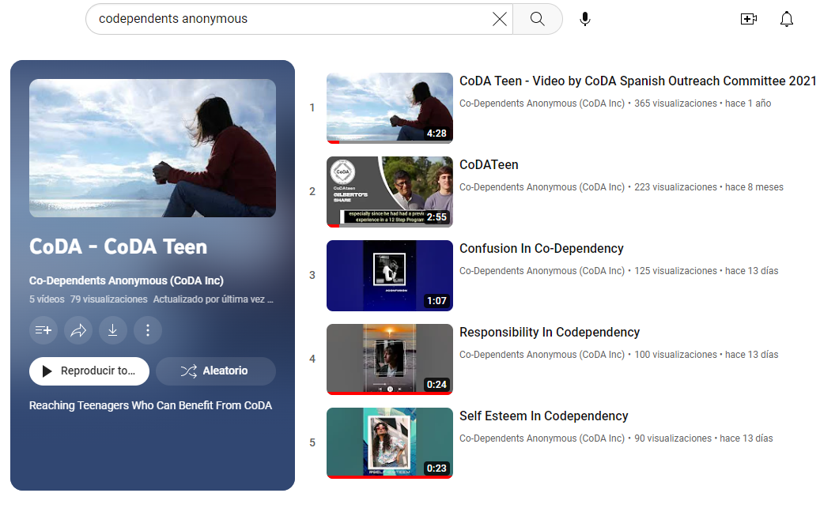
CoDAteen resources available
YouTube channels
Materials on website
English and Spanish

Slide 14
The CoDateen Committee is here for you!
YOUNG PEOPLE NEED US!
Join us today!
…“to carry the message to the teenager who still suffers“
Contact us at Codateen@coda.org

