Slide 1
CoDAteen Task Force
CoDA Service Conference 2022

Slide 2
CoDAteen TaskForce Members
Spanish Speaking Subgroup
Nadia R.- Argentina
English Speaking Subgroup
Gillian A. - UK
Rosa S. - California (SoCal)
Marilyn C. - Guatemala
Jeanne B. - Tennessee
Florence F. - Maryland
Katya R. - Mexico

Slide 3
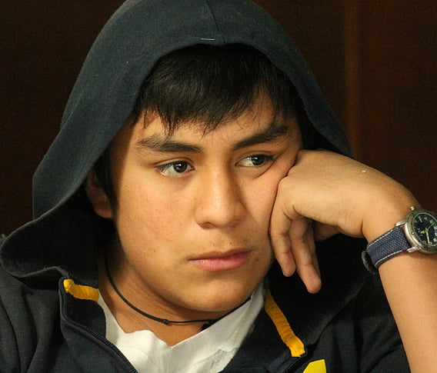
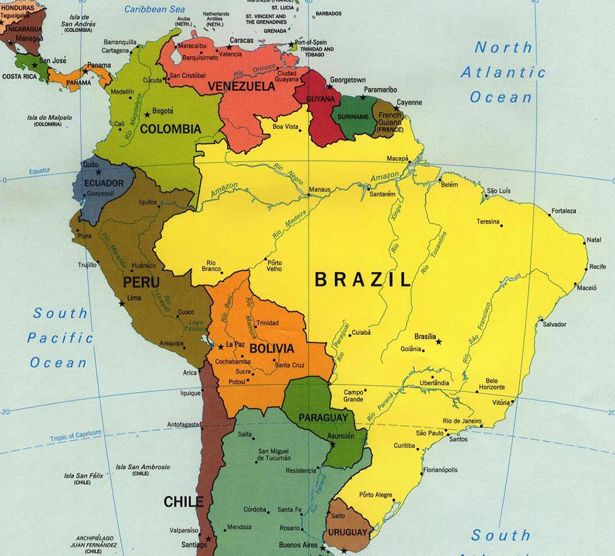
History of CoDAteen
In 2007, CSC disbanded CoDAteen.
All CoDAteen material was no longer to be published and was proposed to be incorporated into material for CoDA Youth.
In 2021, inspired by feedback from the Spanish speaking community, Spanish Outreach (SPO) met with Latin American CoDA and other 12 Step members including teens to gather testimonials.
SPO also found a lack of CoDA literature that speaks to the problems that youth face today.
Spanish Outreach 2021 VisualReport

Slide 4
CoDAteen TaskForce
In response to Spanish Outreach (SPO)'s report in 2021, the CoDA Board formed the CoDAteen Task Force.
They formed two subgroups: English speaking and Spanish speaking.
Translation and interpretation services were used to enable both working groups to share information and work together.

Slide 5
CoDAteen TaskForce Work in Progress
CoDAteen TaskForce did further in-depth research and gained further testimonials.
Reviewed, updated and revised previous CoDAteen material dated back to 2003.
Revised and updated guidelines for CoDA groups to safely sponsor CoDAteen meetings.

Slide 6
Need for CoDAteen
Codependency affects young people too!
Codependency can develop from a very early age often from childhood trauma
Need a safe place to relate to other youth who share their experience, strength and hope.
Alejandro, Gilberto, and Melissa Share
Rosa's Share (1 min.)

Slide 7
Purpose of CoDAteen World Committee Reestablishment of CoDAteen- Board Motion #8
Reach
Reach young people around the world by offering age appropriate meetings that are safe for CoDAteens to share
Develop
Develop structure for CoDAteen
Adapt
Adapt and develop the best processes and resources to reach codependent teens and keep CoDAteens safe
Support
Support CoDAteen meetings already established and to help start new meetings
Continue
Continue to collect feedback from the CoDA Fellowship and CoDAteens

Slide 8
Minimum Behavior and Safety Requirements Board Motion # 11
Alateen meetings have been meeting since 1957 with no known legal or safety issues.
In 2003, Al-anon determined that maintaining the safety of Alateen does affect Al-anon as a whole and developed minimum behavior and safety requirements.
CoDAteen TaskForce crafted minimum requirements inspired by Alateen's practice and previous CoDA approved material. They have been reviewed and approved by CoDA's lawyer.
Legal requirements for adults to work with minors differ according to countries and local areas and these requirements must be observed.

Slide 9
Proposed CoDAteen Structure
CoDAteen meetings must be sponsored by an individual CoDA meeting, Intergroup, Regional area, or Voting Entity and register with CoDA World.
A CoDAteen meeting may not be registered without a sponsoring CoDA group.
The sponsoring CoDA group as above is responsible for vetting and training any adults involved with the CoDAteen meeting.
The CoDAteen committee is responsible for reviewing each group's process for CoDAteen and approve the registration of the meeting.
See CoDAteen Meeting Handbook- Board Motion # 12

Slide 10
Adult Sponsors/Hosts
Adult Sponsors/Hosts of CoDAteen meetings do not act as a sponsor for the teen.
They guide the meetings in order to keep healthy and safe boundaries.
Are responsible for their own behavior, practicing their own recovery as a role model for the teens.
Must abide by the area legal requirements for working with minors.
See CoDAteen Meeting Handbook- Board Motion # 12

Slide 11
CoDA vs. Parental/Guardian Responsibilities
Parental Permission Letter template - Board Motion # 10
Outlines CoDA's and parent's responsibilities
Adult sponsors/hosts are only responsible for what happens during the meeting
In a medical emergency, immediate first aid may be given and emergency contact must be notified
Transportation to and from the meetings should be arranged by the parent/guardian

Slide 12
Boundaries and Safety
Appropriate boundaries are essential and outlined in the CoDAteen Meeting Handbook. - Board Motion # 12
Best practice is to have two adult sponsors/hosts in every meeting.
Keep on hand a list of community resources for physical violence, abuse and suicide prevention etc. - Tradition 6
Be familiar with area/country guidelines and requirements for reporting any suspected child physical or sexual abuse.

Slide 13
WE WANT TO HEAR FROM YOU!
CoDAteen material, CoDAteen Handbook and Step Study are being submitted as a two year process with a draft put on the website for feedback.
CoDAteen groups need to have guidelines and material to use now.
Progress not perfection
Call for action
Contact: Codateen@coda.org

