Slide 1
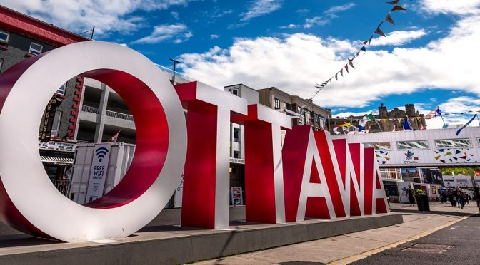
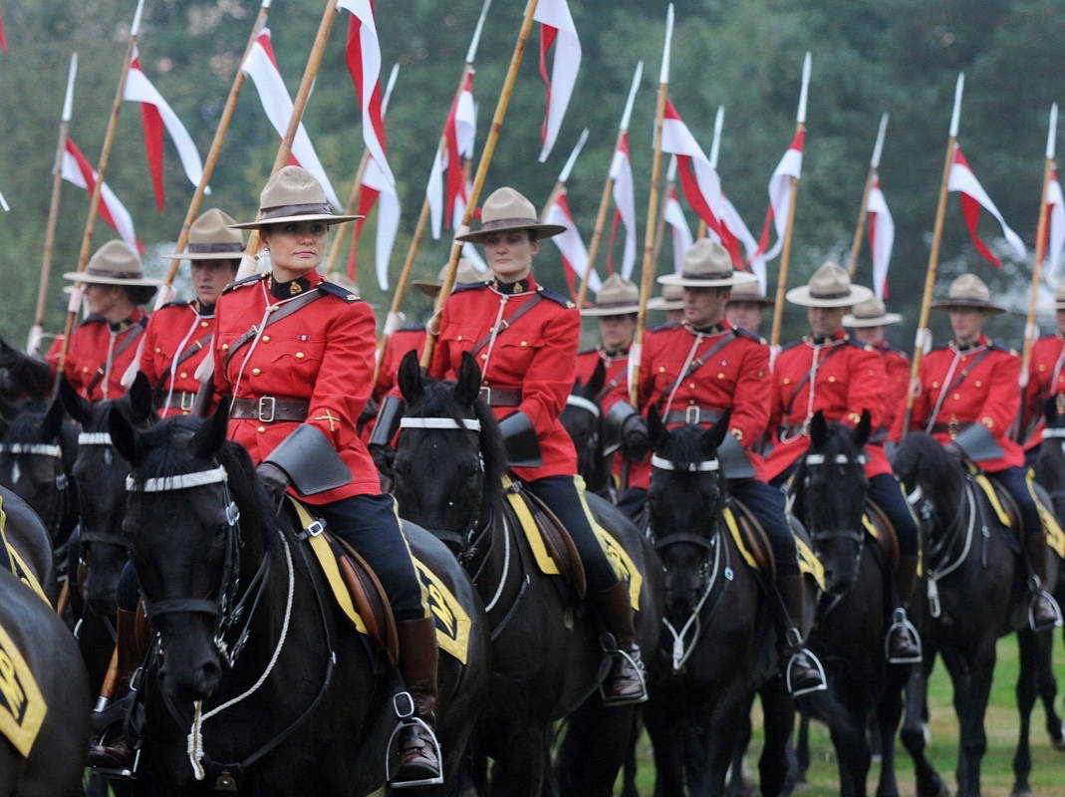
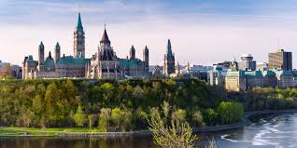
OTTAWA, Ontario CANADA 2024
CSC / ICC
Notes:
WE WISH YOU WERE HERE!
Ottawa is the Capital City of Canada, in the province of Ontario, located 2 hours west of Montreal, Quebec and a short drive north to Gatineau, Quebec.
It stands on the south bank of the Ottawa River in the eastern portion of southern Ontario. Ottawa borders Gatineau, Quebec, and forms the core of the Ottawa–Gatineau census metropolitan area (CMA) and the National Capital Region (NCR).[ As of 2016, Ottawa had a city population of 934,243 and a metropolitan population of 1,323,783 making it the fourth-largest city and the fifth-largest CMA in Canada. In June 2019, the City of Ottawa estimated it had surpassed a population of one million.
Founded in 1826 as Bytown, and incorporated as Ottawa in 1855, the city has evolved into the political centre of Canada. Its original boundaries were expanded through numerous annexations and were ultimately replaced by a new city incorporation and amalgamation in 2001 which significantly increased its land area. The city name Ottawa was chosen in reference to the Ottawa River, the name of which is derived from the Algonquin Odawa, meaning "to trade".
Ottawa has the most educated population among Canadian cities[15] and is home to a number of colleges and universities, research and cultural institutions, including the National Arts Centre, the National Gallery, and numerous national museums. (Wikipedia) https://en.wikipedia.org/wiki/Ottawa
As Canada’s capital, Ottawa is the perfect place to experience some of the country’s best attractions, celebrations and flavours.
Within a short walk from your hotel, you can tour iconic Parliament Hill, visit many of the country’s national museums, and take an epic paddle, cruise or skate on the Rideau Canal—a UNESCO World Heritage Site. Around every corner on both the Ontario and Quebec sides of the Ottawa River, lively neighbourhoods beckon you with tasty craft beer, fresh local food and unique shopping experiences.
Pristine outdoor spaces within the city and in the nearby countryside offer a bounty of activities including cycling, rafting, hiking and skiing. And no matter the season, events like Winterlude, the Canadian Tulip Festival and Bluesfest fill the city with excitement and beauty.
Live the ultimate authentic Canadian experience and create unforgettable memories in Ottawa, Canada’s capital!
Discover more about Ottawa through its vibrant neighbourhoods and on the Ottawa Tourism blog: https://youtu.be/OMuZpC-eQMY
https://ottawatourism.ca/en/about-ottawa

Slide 2
Ottawa’s CoDA ThursNoon Group
and
CoDA Ontario Intergroup
Looks forward to hosting you
at
CSC/ICC 2024!

Slide 4
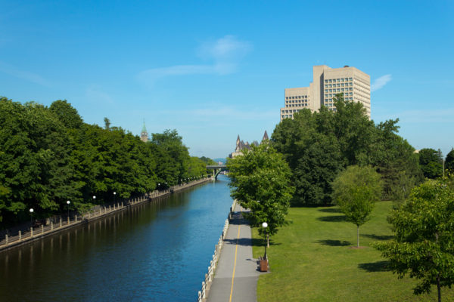
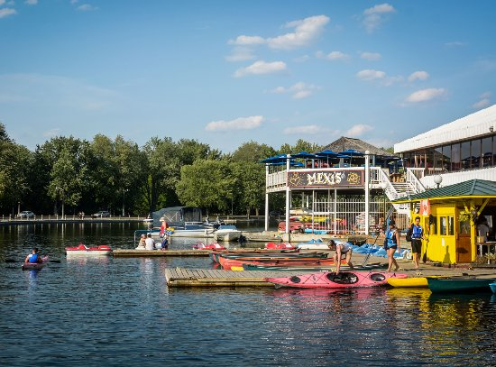
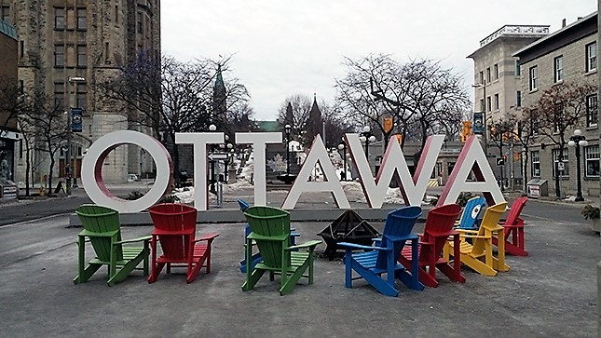
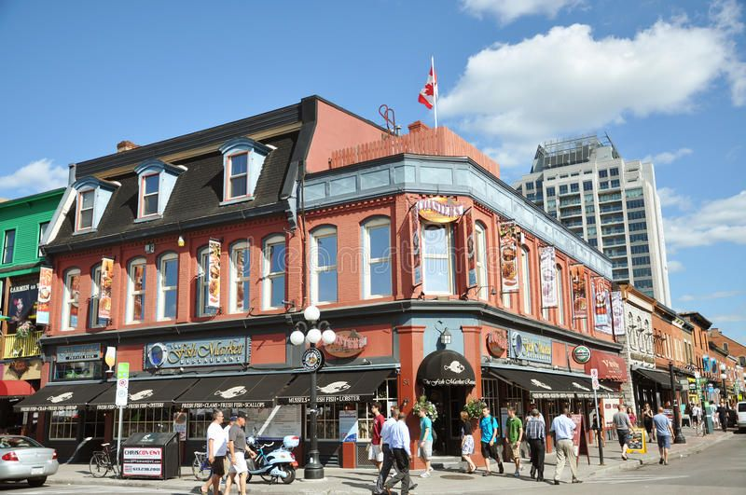
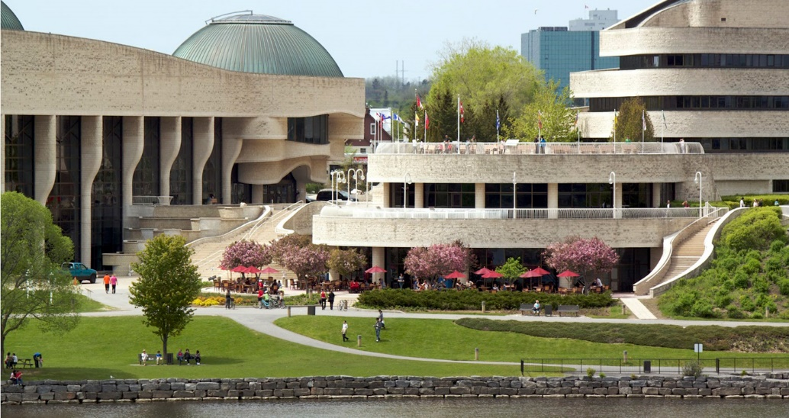
Notes:
Must sees in Ottawa: the laid back feel of parks and beautiful gardens, Parliament Hill and the Peace Tower , Ottawa River pathway (behind the Parliament buildings which can be walked to reach a couple museums), Rideau Canal, Byward Market, Spark Street Mall, Buskers performances on the sidewalks, 7 National Museums: Canadian War Museum, National Art Gallery of Canada, Canadian Museum of History with the Children’s Museum and CINÉ+ 3D theatre (in Gatineau), Aviation and Space Museum, Science and Technology Museum, Canadian Museum of Nature and Canada Agriculture and Food Museum (near Dows Lake). Most museums are free to visit 4-8pm…call to confirm.
Then there is also Dows Lake Pavilion, Major Hills Park, National Arts Centre, Notre Dame Basilica, Canadian Mint, Governor General’s Rideau Hall.
At a distance: Chelsea and Wakefield, National War Memorial, Diefenbunker - Canada's Cold War Museum, Landsdown farmers’ market in The Glebe, Westboro Village, hiking trails of Ottawa NCC or Gatineau Park, swimming at Mooney’s Bay.
Tours like the Lady Dive, Hop-On-Hop-Off Sightseeing, City Bike, Jail, Ottawa River or Rideau Canal Cruise, Tourist Scavenger Hunt, Pioneering Days Audio

Slide 5
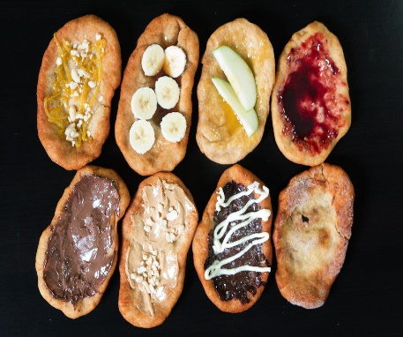
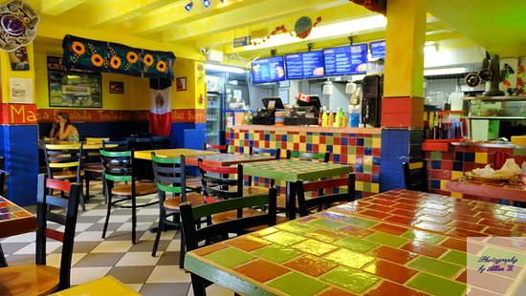
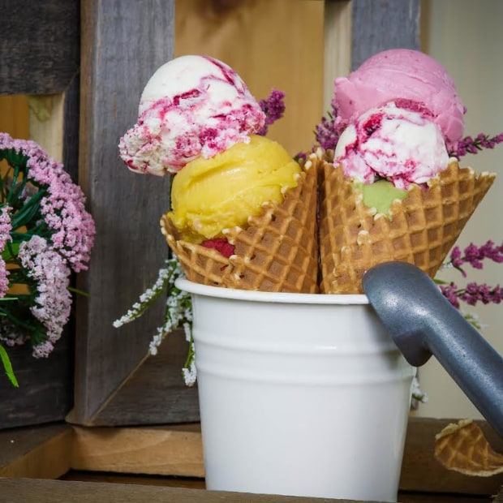
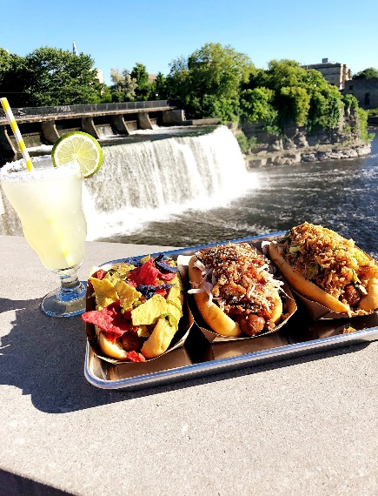
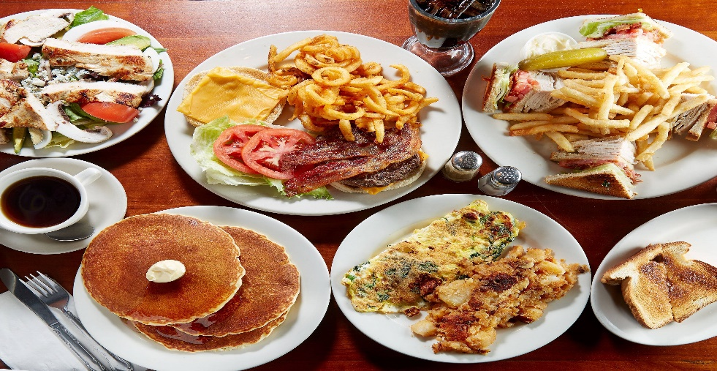
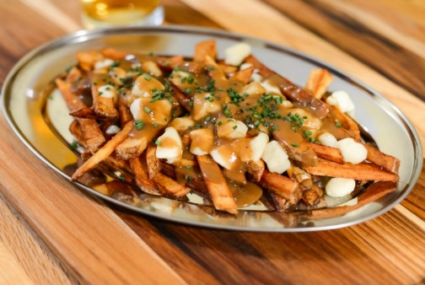
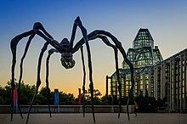
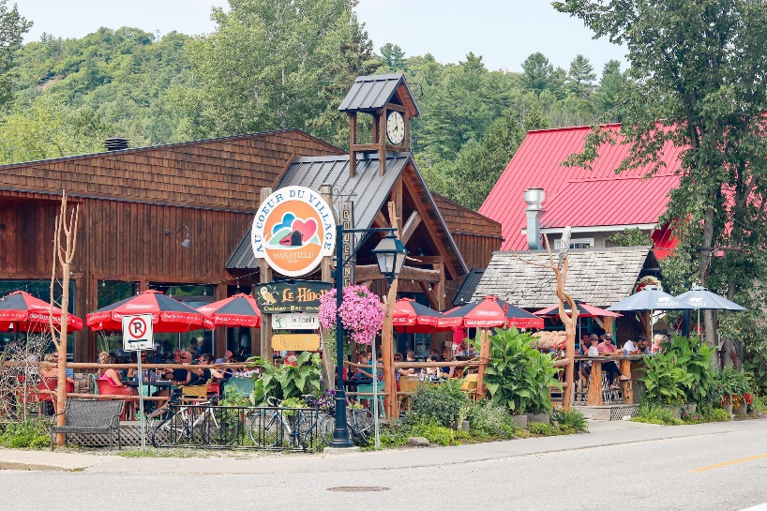
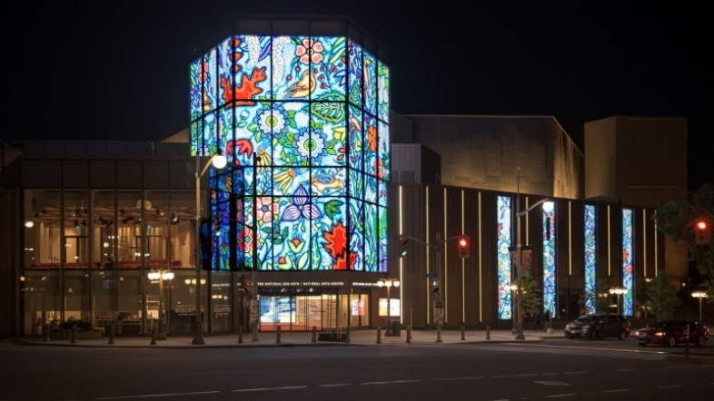
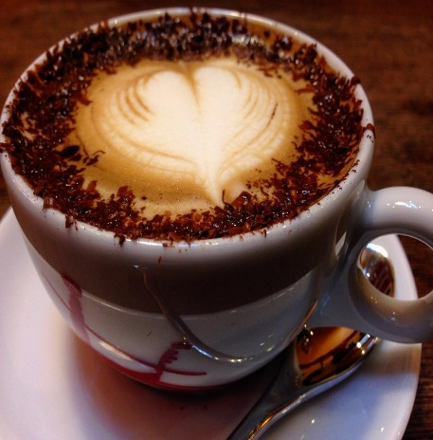
Notes:
The Poutine is truly Canadian! Home grown potatoes, cheese curds, especially St. Albert’s curds, and gravy smothering it all! It originated in the Canadian province of Quebec and emerged in the late 1950s in the Centre-du-Québec area. It has long been associated with Quebec cuisine.
BeaverTails are a uniquely Canadian tradition, hand-made wholewheat pastries are served up with a variety of toppings at special events throughout the year and at the original kiosk in the ByWard Market.

Slide 6
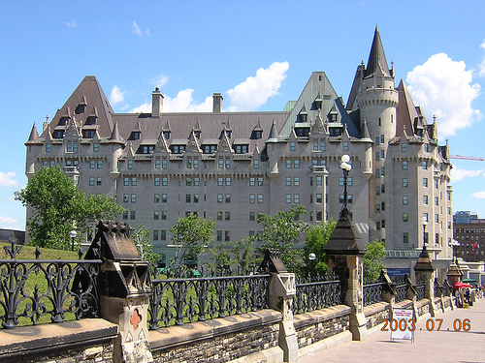
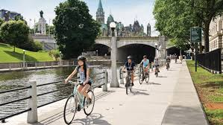
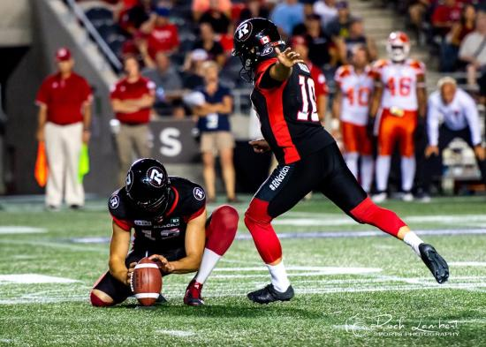
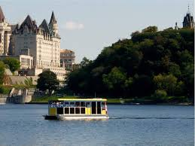
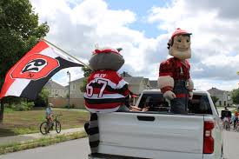
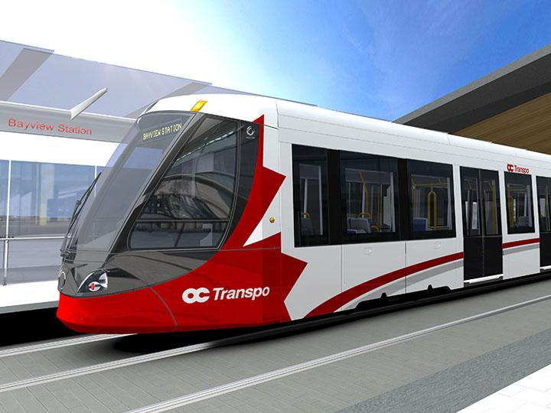
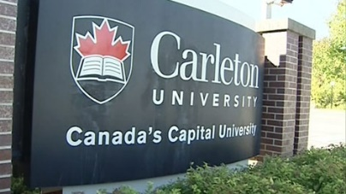
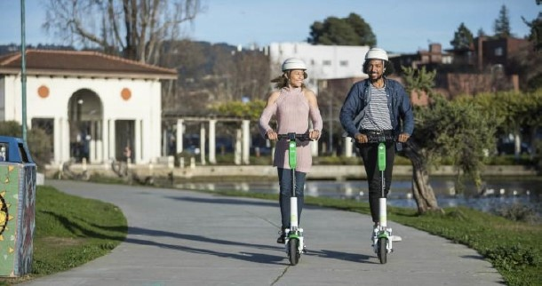
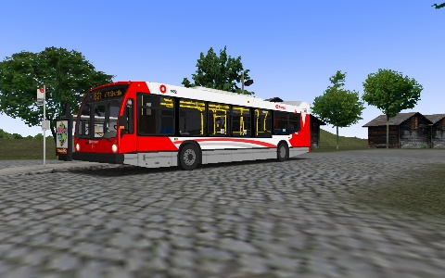
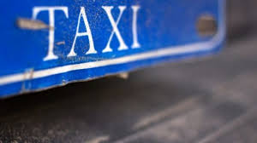
Notes:
Some of the sights, sports and modes of transportation in downtown Ottawa are seen here: OC Transpo bus and light rail, taxis, Uber/lyft to and from the airport; bikes and scooters and walking shoes for the downtown; a water taxi to Gatineau Quebec is fun or use the traditional bus [Société de transport de l'Outaouais (STO)], taxis, Uber/lyft or take a rented bike or scooter across the Ottawa river
Ottawa International Airport – YOW information: https://yow.ca/en/yow-plus/overview; Terminal maps: https://yow.ca/en/travel-planning/terminal-maps; International travel: https://yow.ca/en/travel-planning/travelling-to-yow with a link to Canadian Boarder Services Agency: https://www.cbsa-asfc.gc.ca/

Slide 7
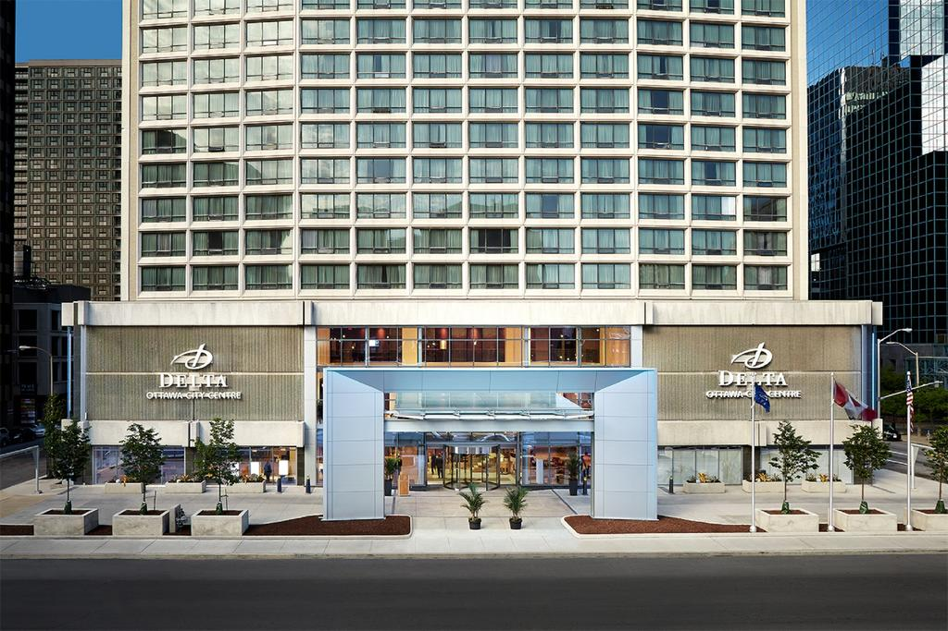
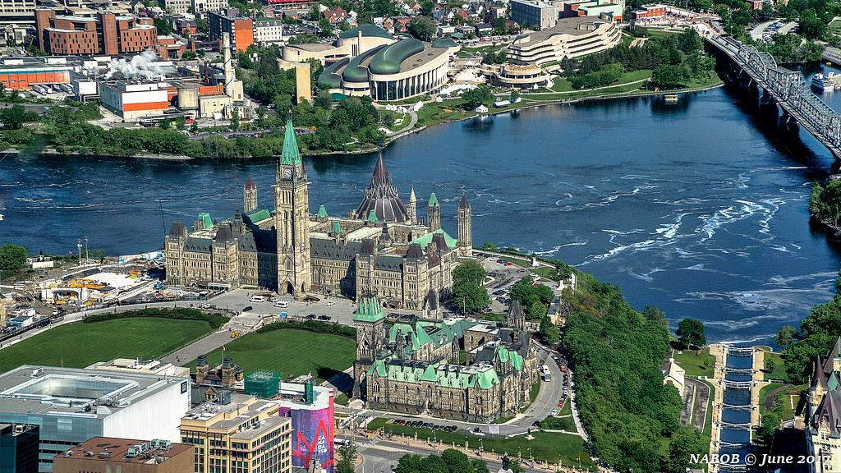
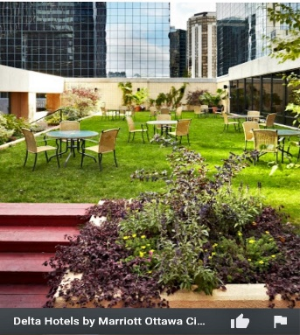
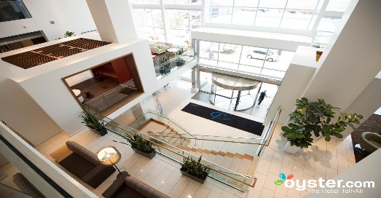
https://ottawatourism.ca/en/about-ottawa
Notes:
We look forward to seeing you in person and share the sights, sounds and fresh air of the surrounding rivers of Ottawa – the Ottawa River and Rideau Canal
https://ottawatourism.ca/en/about-Ottawa Hospitality Suite Volunteering and Committee SignUp: https://www.signupgenius.com/go/9040e45acab29a6fa7-hospitality1#/

