Slide 1
Southern California VE
2024 CSC Presentation
By Vanessa CF, Lindsay S, Linnea M

Slide 2
You might think of Hollywood and beaches but we’re so much more!

Slide 3
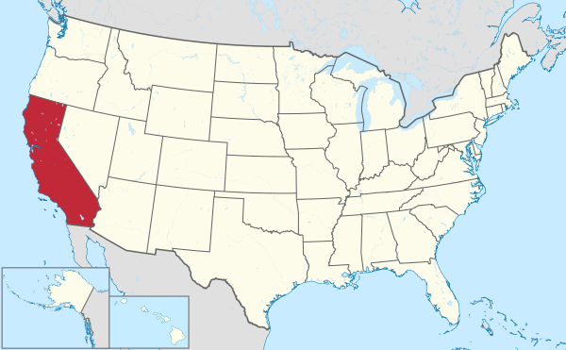

Slide 4
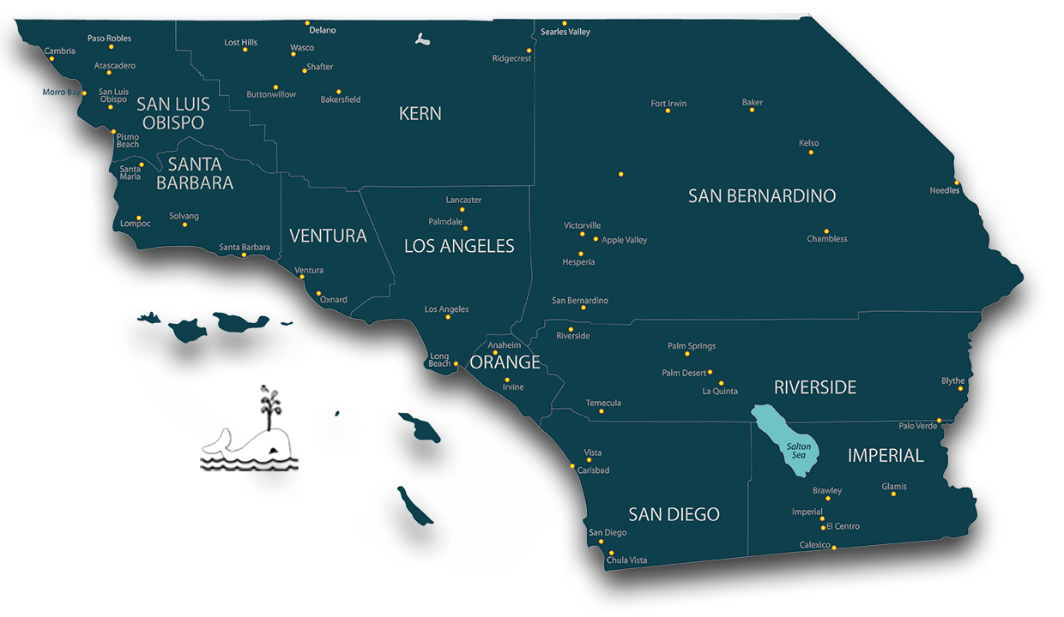
Fun Facts
The Salton Sea has enough lithium to power EV car batteries worldwide, alone, for decades
Harry & Meghan and Oprah live in Santa Barbara County
Los Angeles County, alone, is 10 million people
Around 40% of all goods in the US original from the LA/Long Beach major Port complex

Slide 5
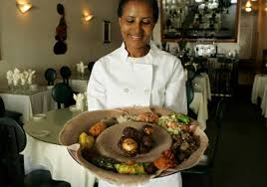
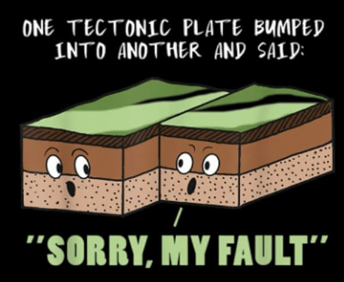
Culturally speaking
Yes we have earthquakes but they are mostly small (and some of us like them!)
Our defining feature may be our diversity (socially, politically, and geographically)
San Diego has a significant military presence (remember the movie Top Gun or Maverick?)
In many ways culturally connected to Mexico

Slide 6
What does CoDA look like in SoCal?

Slide 7
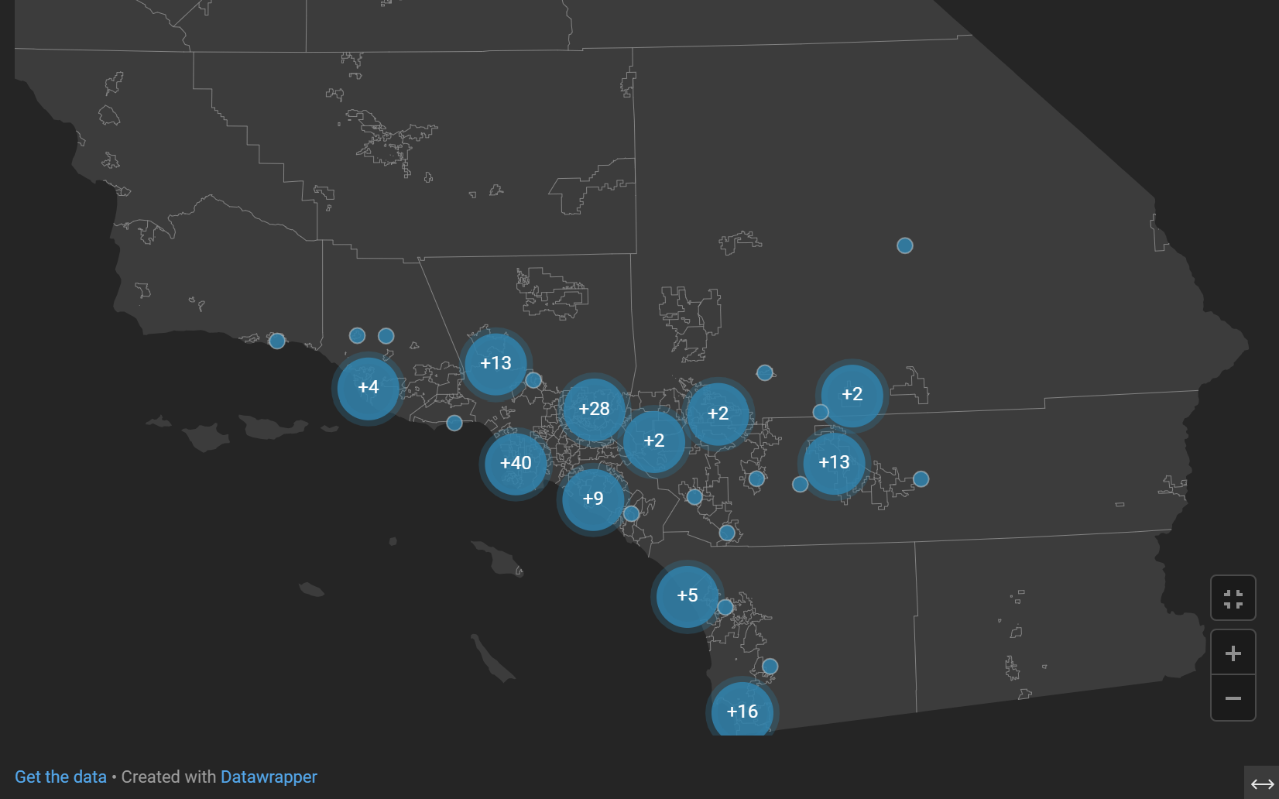
Intergroups & Meetings
152 mtgs
not including online meeting that may originate in SoCal
Notes:
155 meetings: Found this number by downloading all the California meetings and then identifying which ones are in SoCal. 7/24/24

Slide 8
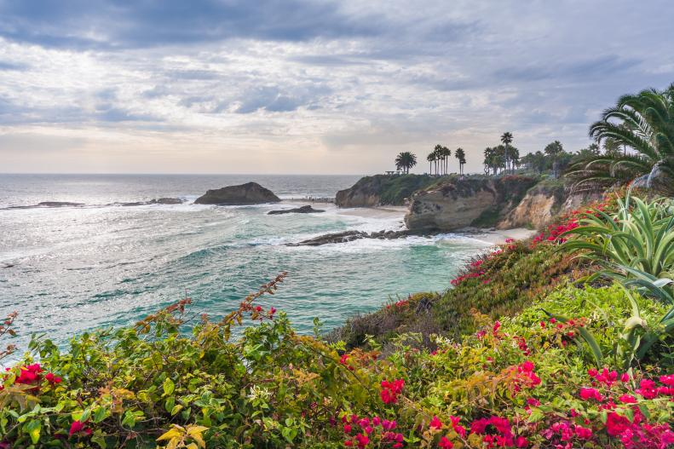
Intergroups & Meetings
Notes:
155 meetings: Found this number by downloading all the California meetings and then identifying which ones are in SoCal. 7/24/24

Slide 9
What issues are important to us?

Slide 10
What’s on our minds in SoCal?
Some members responses to: “What specific issues or topics are most important to the SoCal CoDA community right now, and how can we bring these to the attention of World CoDA?”
13th stepping
Concerns about how to revive H&I, outreach, service, and meetings that collapsed during the pandemic
Desire for gender inclusive language
Concerns for collaboration at all levels of CoDA
Some of our intergroups are struggling to remain cohesive - one is coming back from disarray
We just had our first bi-lingual (English - Spanish) conference!
Notes:
ANSWERS FROM THE SURVEY:
For me, CoDA is a nurturing program that inspires members to open up to their possibilities,which go way beyond the rooms. If the world interacted like we do in our rooms, there would be more collaboration and less posturing.
Have non-binary terms in all materials. Eg: instead of saying men and women, use the word people, to be inclusive of all gender identities.
SoCal CoDA has eliminated the H&I position. San Diego CoDA does not have meetings in the jails since Covid. Outreach is also suffering from lack of service. Any suggestions from the World CoDA Community to support H&I and/or Outreach at the local level would be useful.Please bring this up in conference and return with ideas for what is working elsewhere.Thanks.
On the whole, I would say that the concept and resulting issues of “Thirteenth Stepping” were a major point of discussion throughout the SoCal CoDA community this past year (e.g., whatcounts as 13th stepping, what to do if another member is making you uncomfortable, the idea of implementing “dress codes” for meetings, etc.).
We need new ways to encourage service at all levels. Every 12 Step program struggles with this same issue. I don't think people new to 12 Step recognize service as a tool of recovery and view this concept as a form of manipulation to gain their labor for free. We all lose.... :-(
support on how to revive an intergroup after the pandemic

