Slide 1
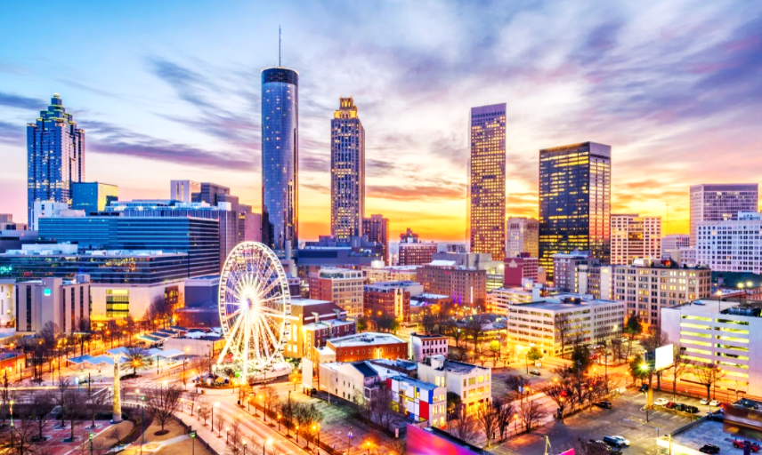
Georgia
Notes:
photo via Canva

Slide 2
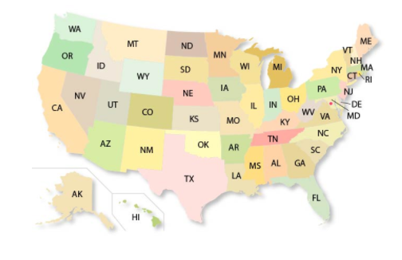

Slide 3
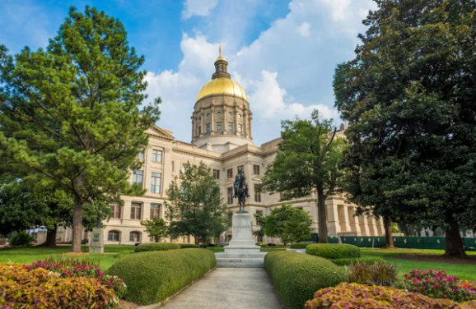

Slide 4
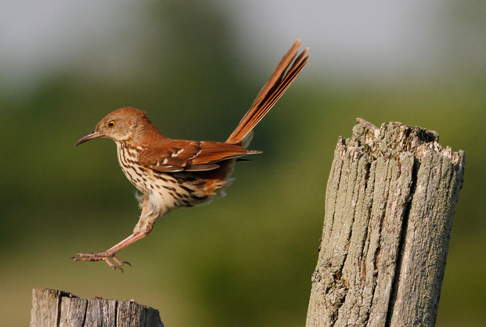

Slide 5
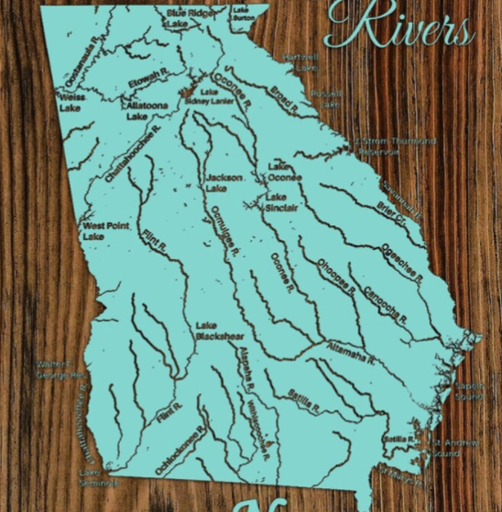

Slide 6
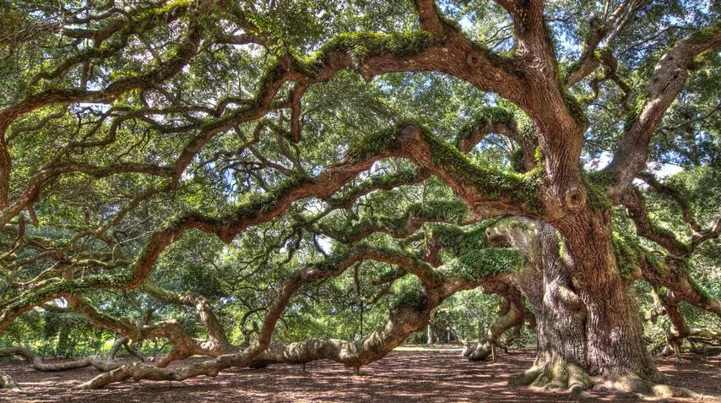

Slide 9
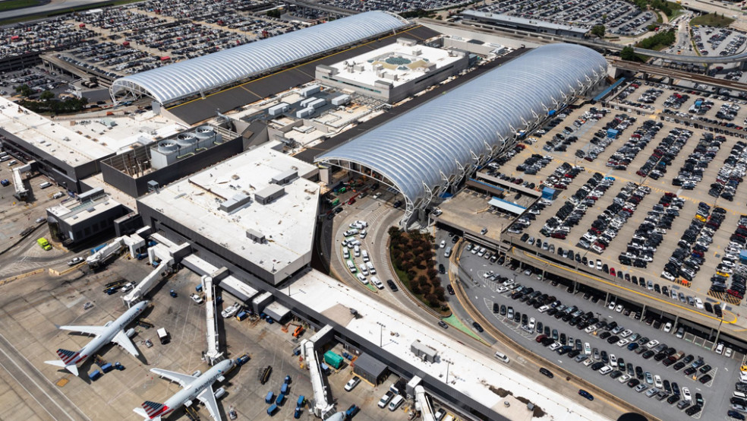
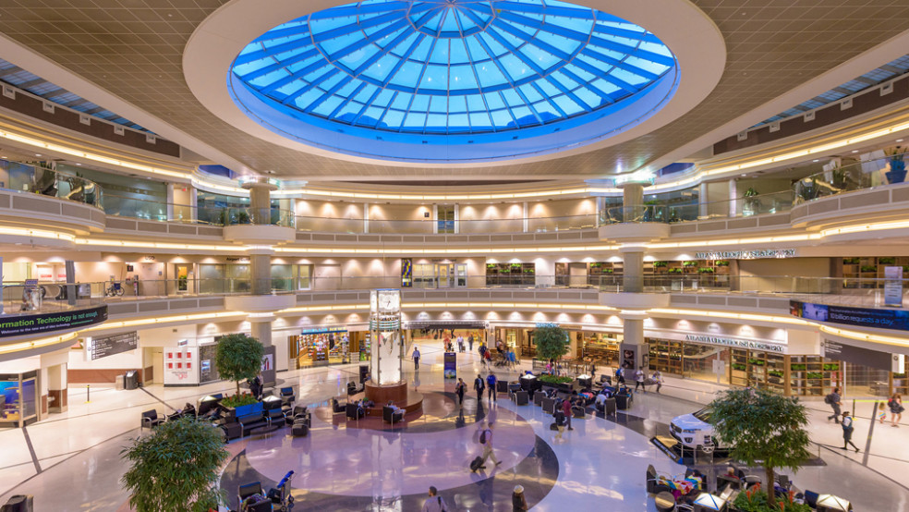

Slide 10
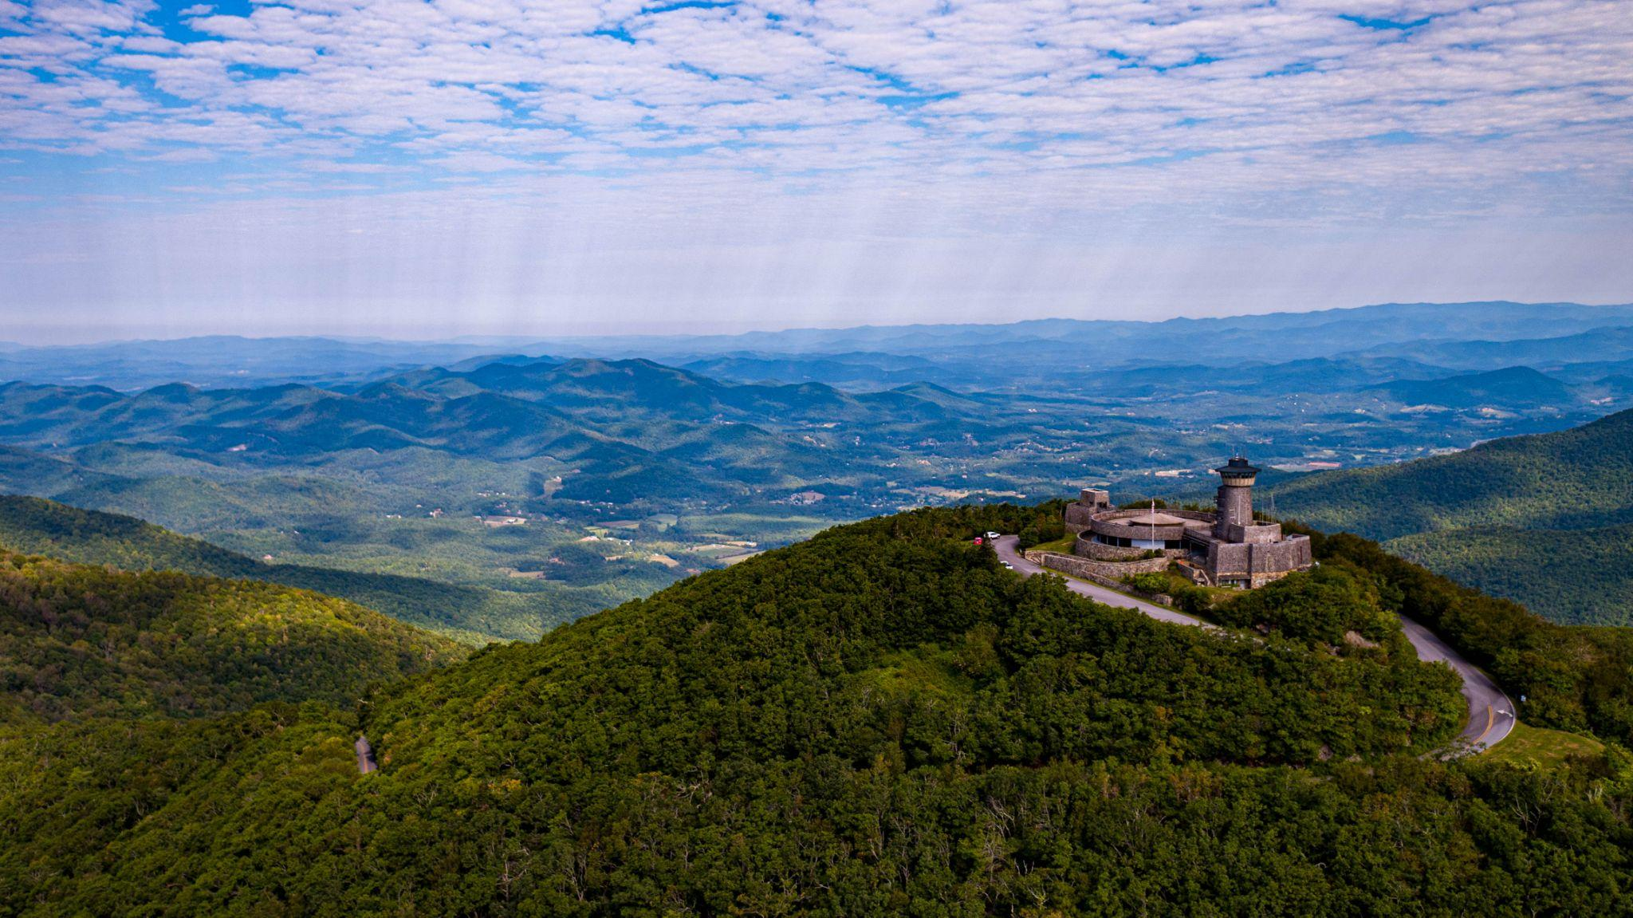
Notes:
Georgia facts
The capitol is Atlanta. The official State Bird of Georgia is the Brown Thrasher; the State Fish is the Largemouth Bass; and the State Tree is the Southern Live Oak. Georgia’s State Motto is “Wisdom, Justice, Moderation.”
Considered the “Hollywood of the South”
Hartsfield-Jackson Airport is the busiest in the world
Highest elevation point is Brasstown Bald (4,784 feet high)
71 streets with “Peachtree” in their name
Savannah is the “most haunted city” in the USA
Photo and Info cred: https://blueridgemountainstravelguide.com/fun-facts-about-georgia-state-history-culture/

Slide 11
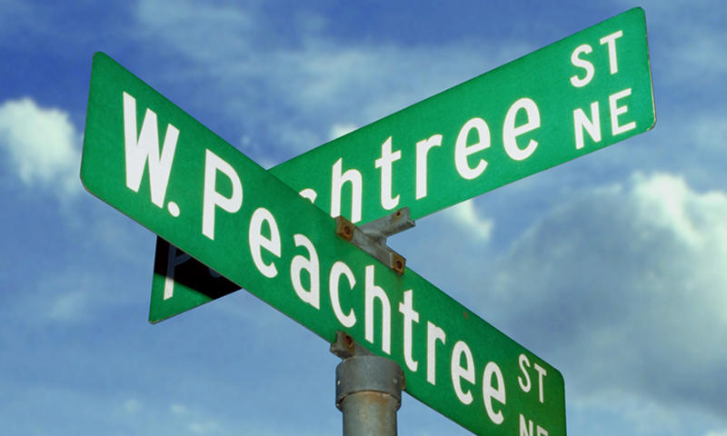

Slide 12
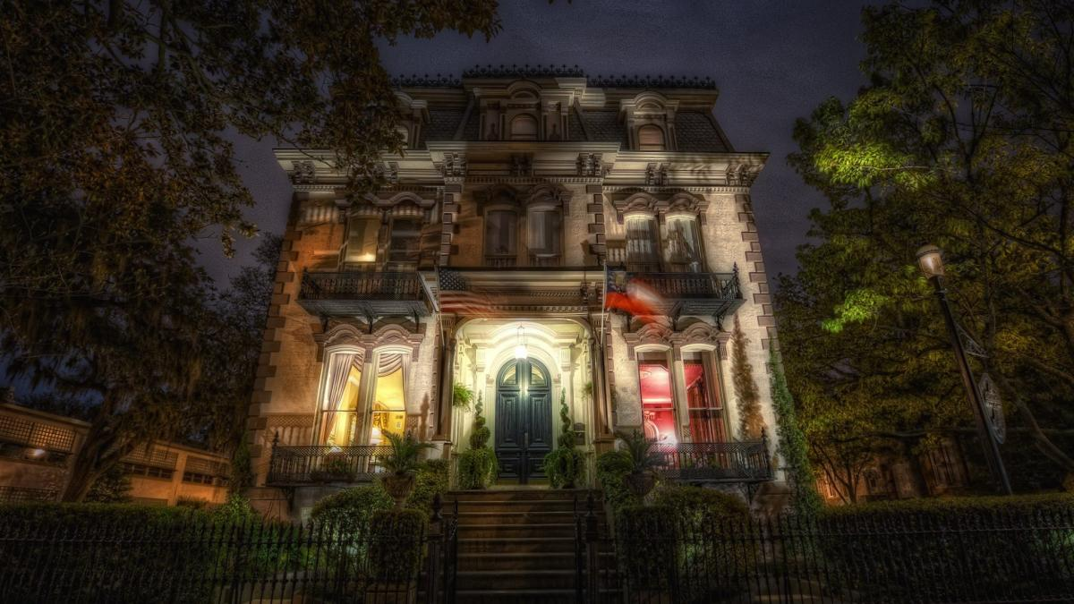

Slide 13
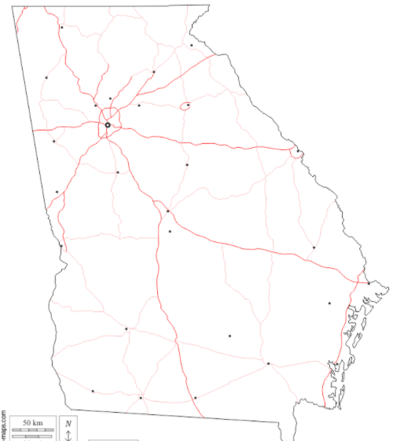
Current
Meetings

Slide 14
Atlanta CoDA
Grateful CoDA (GA 179 & GA 162)
Wed 7pm & Sun 8pm
@Triangle Clubhouse
Core CoDA (GA 200)
Sat 8pm
@Galano Clubhouse
Double Winners (GA 183)
Thur 8pm
@Biscayne Room
Man Up (GA170)
Wed 7:30 pm
@ Serenity Clubhouse
Meaningful Mondays (GA 006)
Mon 7:30 pm
@Intown Community Church

Slide 15
Valdosta CoDA
Valdosta CoDA (GA 198)
Mon 6:30 pm
@Unitarian Universalist Church

Slide 16
Marietta CoDA
Monday Night New Insights (GA 127)
Mon 7:30

Slide 17
Lawrenceville CoDA
Tuesday CoDA (GA 020)
Tues 7:30 pm
@McKendree United Methodist Church

Slide 18
Augusta CoDA
Dimmer Switch Group (GA 193)
Thur 7pm
@FocusOnRecovery

Slide 19
Smyrna CoDA
Thursday Night CoDA (GA 044)
Thur 7pm
@Ridgeview Institute

Slide 20
Snellville CoDA
Snellville CoDA (GA 191)
Thur 7:30 pm

Slide 21
Kennesaw CoDA
Nourish and Flourish (GA 146)
Thur 7:30 pm
@The Lazy Labrador Coffee House

Slide 22
Johns Creek CoDA
Johns Creek CoDA (GA 003)
Sat 10am
@Mount Pisgah UMC

Slide 23
East Roswell CoDA
Bridge To Recovery CoDA (GA 197)
Sat 10 am

Slide 24
Past Georgia CoDA:
Revival of Georgia CoDA in 2015 after almost 10 years of not having a VE
Hosted CSC/ICC 2000 and 2019 in Atlanta, Georgia.
Hosted one of the most successful hospitality suites at CSC/ICC 2019, feeding more than 75 people
[“We had a lot of fun, a place to relax and hang out.” ]
We have two voting delegates at each CSC
We have hosted “Share Days” biannually
We have a focused LGBTQIAA+ meeting
Hosted the events committee at Mary Mac’s Tea Room

Slide 25
Current Georgia CoDA:
Host “Share Day 2021” and elected a new board of officers (Fall 2021)
Updated the bylaws (Early Spring 2022)
Monthly officer meetings and quarterly Ga CoDA meetings via Zoom
Updated all meeting listings for the state of Georgia so newcomers can find and make meetings with ease
Hosted a successful Georgia CoDA Summer Picnic
Mediated local groups offering the Twelve Traditions, “Healthy Meetings Matter” booklet, the “Dealing With Disagreements” pamphlet, and the FSM Part 1 page 24-29

Slide 26
Future Georgia CoDA:
Continue to hold monthly officer meetings and quarterly Ga CoDA meetings via Zoom
Continue to update the listings
Call and visit each group twice a year to extend support/ see what their needs are
Host Share Day 2022 including CSC/ICC reports, speakers and a panel discussion to share experience/strength/hope, fellowship, networking
Identify local hospitals and institutions, develop relationships, provide any requested literature or libraries
Host an event Quarterly ie. Winter outing (ice skating, Snow Mountain tubing, Hot Cocoa Bar), Spring (Bonfire/letting go ceremony or Silent Hike) Summer Outing (picnic or scavenger hunt), Fall (Share Day)
Host quarterly forums on topics like “Find your groove: Service Structure”, “Sponsorship”, “Starting Meetings”, “7th Tradition fund distribution”, “Network Building”, “Fellowship”, etc.

