Slide 1
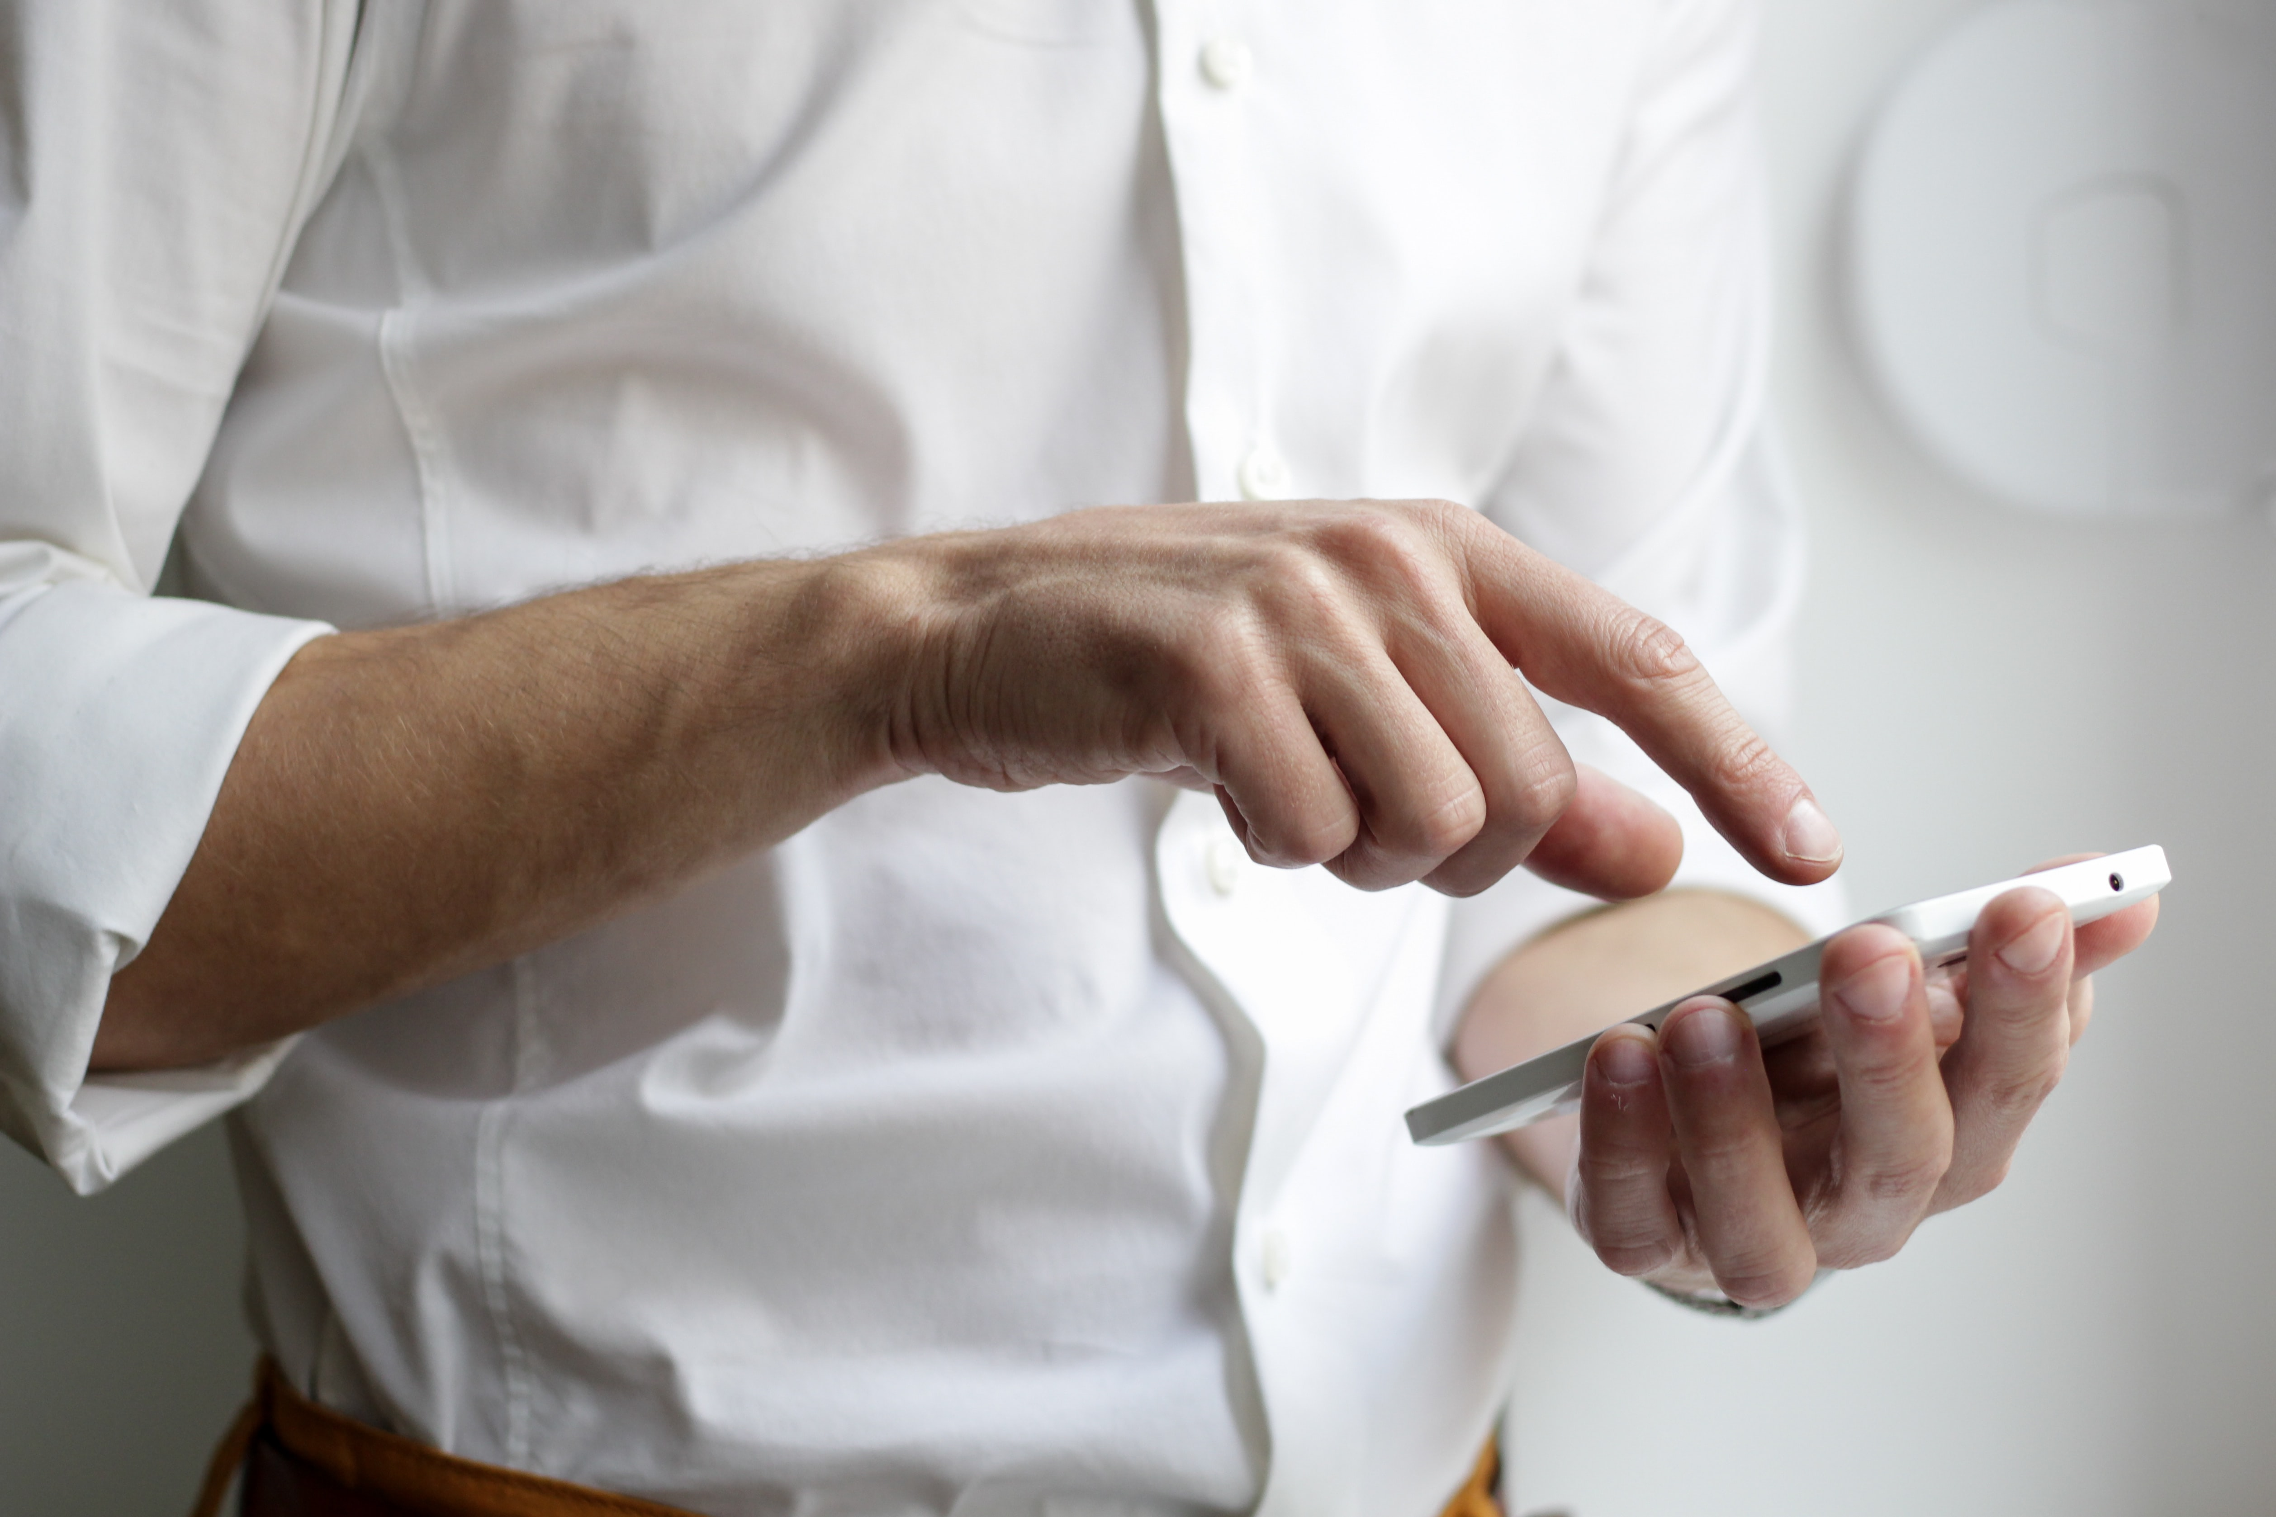
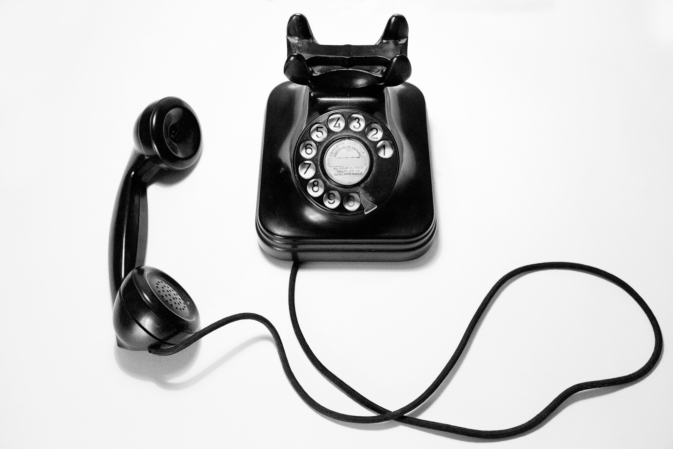
Communication Committee
CET
C-phone
At Large
2022-2023 Goals/Objectives +
2022 Report
Fellowship Forum
AVM
C--Phone
Ideas Welcome!

Slide 2
Communication Committee 2022 - 2023 Goals/Objectives
continue to serve the fellowship through answering emails and phone calls. | continue to have volunteers for each day for both CET (CoDA Email Team) and C-phone (CoDA - phone)
Fellowship Forum growth and maintain consistency | Continue to have monthly forums. Add speakers from volunteers with a variety of topics
Revive AVM (Audio/Visual/Media) with new ideas | The AVM was created to allow videos and audios to be added to the CoDA YouTube site. The board ended up doing this (miscommunication) so we will be looking for new ways to serve the fellowship in this fashion. Looking for ideas, if you have any - comm@coda.org

Slide 3
Members
Fellowship forum: James K - PA David - NY
At large: Kaga - VA Jeanne – IL
CET: Raul - IN Krista – FL Dayle - NY Chris - OK Lizzie - VA Mary - NC
C-phone: Raul - IN Michelle - SC Dayle - NY Chris - OK Daniel - GA Charlotte – NC Linda – CA
AVM – Interested???
Four subcommittees and an at-large group comprise the Communication Committee. Each has different duties, and together we assist the fellowship in various ways. We happily invite you to join us in any of these!

Slide 4
The Fellowship Forum
is held every month with various topics each month; a speaker is followed by fellowship for questions, answers, discussions. David and James have worked hard to provide a wide variety of topics and active discussions. There has been an increase in attendance and greater participation by the fellowship. In the coming year, the forum looks forward to a greater variety of topics. We would like to invite guest speakers to share their unique experiences as they share their strengths and hope for recovery. Are you willing to share on a recovery topic of your choice? Contact Comm@CoDA.org subject line Fellowship Forum
If you are interested in joining us as we continue the journey of recovery, the forum is the last Saturday of the month, every month; for more information, use this link: https://coda.org/meeting-materials/coda-fellowship-forum/

Slide 5
The CET and C-phone teams
have worked hard this past year, answering calls and emails from the fellowship. They answer questions such as ‘where can I find a meeting’, to ‘I am new, what do I do?’ to ‘I need a sponsor’, and anything in between! The committee fields calls and emails from members reporting issues in meetings and unhealthy meeting atmospheres. The response time is normally just 24 hours, and we do our best to help or get them to the people who can. The email team has answered 943 emails in quarters 3 and 4 of 2021 and the first two quarters of 2022. Approximately 463 phones calls have been returned by the phone team this year. To email the team: info@coda.org. To call and leave a message:
+1 (602) 277-7991 (AZ)
+1 (888) 444-2359 (Toll Free)
+1 (888) 444-2379 (Spanish)

Slide 6
AVM (Audio/Visual/Media)
This team began after a motion at CSC made clear that it is okay to have video presentations on the CoDA YouTube channel. It originally was planned to get videos and audios from the various intergroups and Voting Entities and have them uploaded to the YouTube channel. The CoDA board began doing this with the help of a fellowship service worker, so we have had to re-think the idea. We are looking for ideas and volunteers for this project. If you have any ideas you’d like to suggest, please email comm@coda.org. For instance, would you like to create a podcast and facilitate it? Any other ideas??

Slide 7
At Large
These members assist in many different areas of the committee; they attend the Committee meetings, provide historical information, and are a great resource for ideas and planning.

